Slide 1

Application: Healthify Type: Application Architecture View: Logical View Style: Layered Architecture Pattern
Users
Delivery Channels
Core Business Processes
Data And Information
Technology Enablers
Registration
User Details
Payment Gateways
Users
Appointment Scheduling
Appointment Records
Security Protocols
Medical History
Web Browser
Appointment Management
Prescriptions
Database Management System
Patient Record Management
Healthcare Providers
Billing Information
Application Server
Prescription Management
Doctor details
Cloud Services (AWS )
Billing and Payment
Finance
Github & Delivery Pipeline
Administrator
Finance

Slide 2
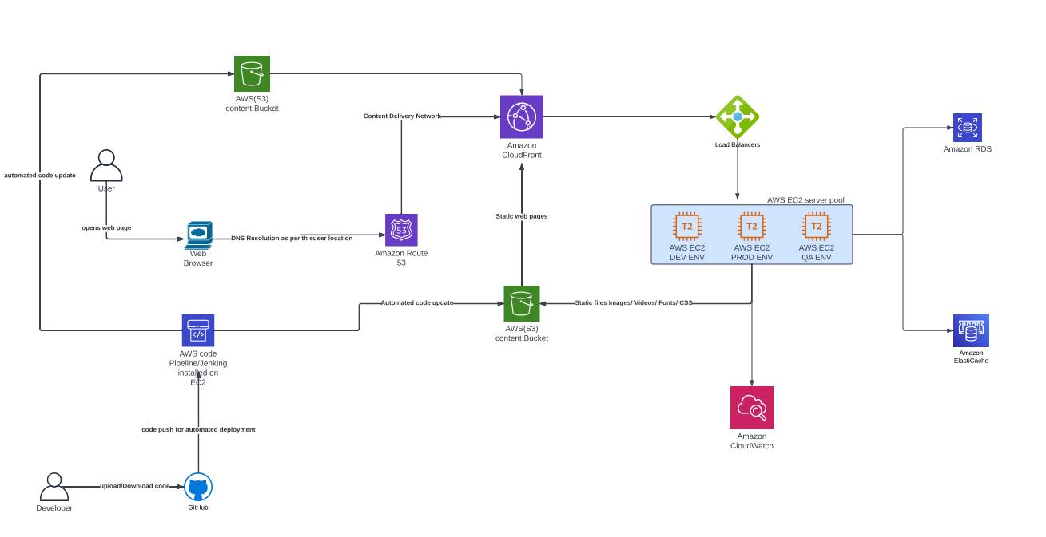
Application: Healthify Type: Application Architecture View: Process View Style: Client-Server Pattern

